Slide 1

Module 12: Network Troubleshooting
Enterprise Networking, Security, and Automation v7.0 (ENSA)

Slide 2
Module Objectives
Module Title: Network Troubleshooting
Module Objective: Troubleshoot enterprise networks.
Topic Title | Topic Objective
Network Documentation | Explain how network documentation is developed and used to troubleshoot network issues.
Troubleshooting Process | Compare troubleshooting methods that use a systematic, layered approach.
Troubleshooting Tools | Describe different networking troubleshooting tools.
Symptoms and Causes of Network Problems | Determine the symptoms and causes of network problems using a layered model.
Troubleshooting IP Connectivity | Troubleshoot a network using the layered model.

Slide 3
12.1 Network Documentation

Slide 4
Documentation Overview
Network Documentation
Accurate and complete network documentation is required to effectively monitor and troubleshoot networks.
Common network documentation includes the following:
Physical and logical network topology diagrams
Network device documentation that records all pertinent device information
Network performance baseline documentation
All network documentation should be kept in a single location and backup documentation should be maintained and kept in a separate location.

Slide 5

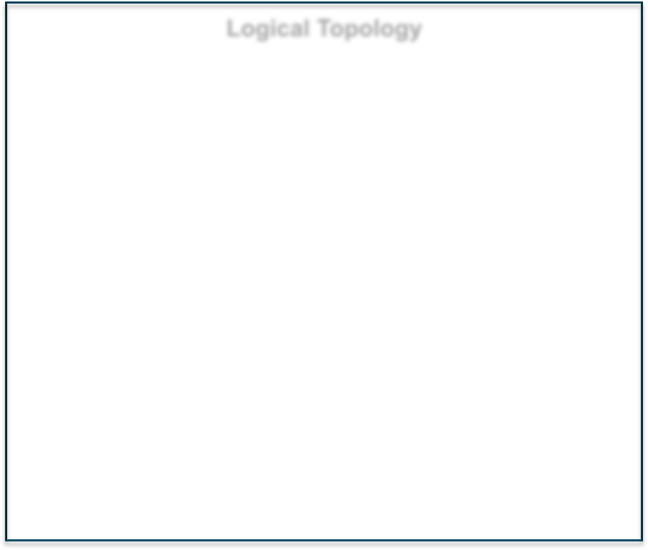
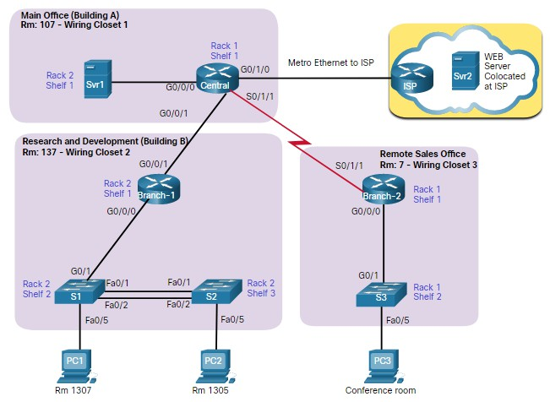
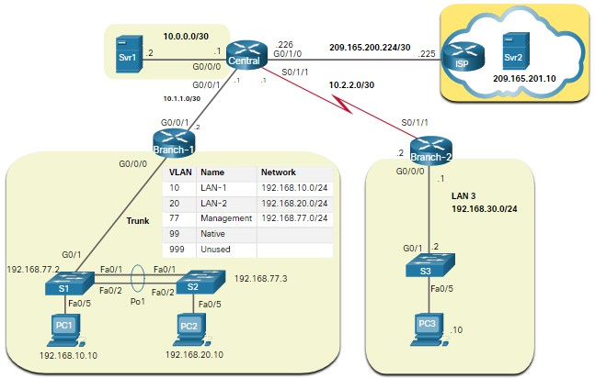
Network Documentation
Network Topology Diagrams
There are two types of network topology diagrams: physical and logical.
Physical Topology Logical Topology

Slide 6
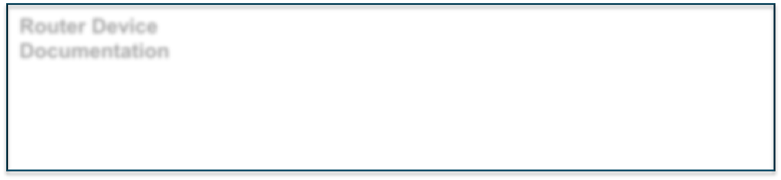
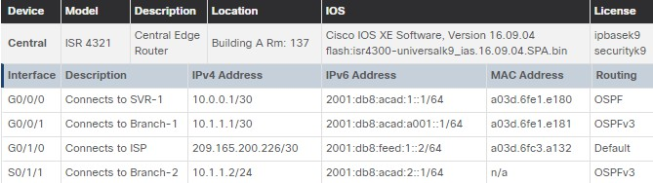
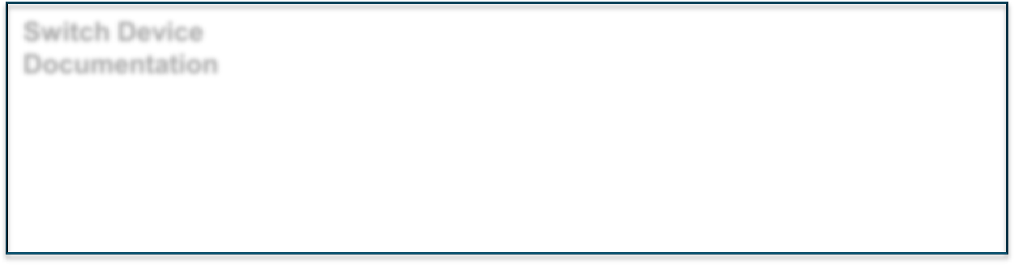
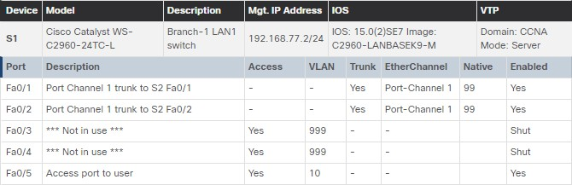
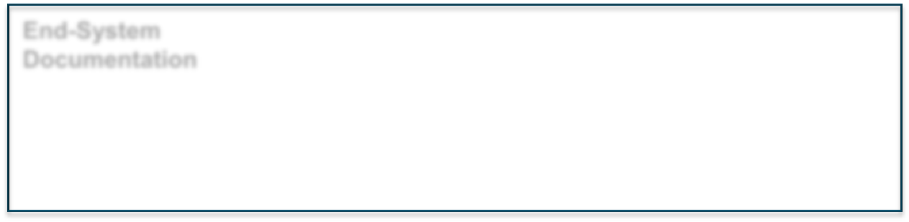
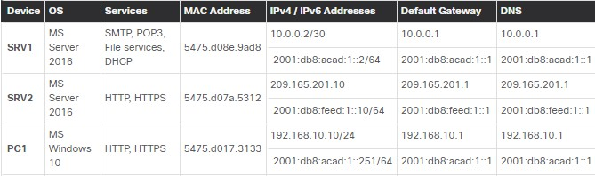
Network Device Documentation
Network Documentation
Router Device
Network device documentation should contain accurate, up-to- date records of the network hardware and software.
Documentation
Switch Device Documentation
Documentation should include all pertinent information about the network devices.
End-System
Documentation

Slide 7
Establish a Network Baseline
Network Documentation
A network baseline is used to establish normal network performance to determine the “personality” of a network under normal conditions. Establishing a network performance baseline requires collecting performance data from the ports and devices that are essential to network operation.
The baseline data is as follows:
Provides insight into whether the current network design can meet business requirements.
Can reveal areas of congestion or areas in the network that are underutilized.

Slide 8
Network Documentation
Step 1 - Determine What Types of Data to Collect
When conducting the initial baseline, start by selecting a few variables that represent the defined policies.
If too many data points are selected, the amount of data can be overwhelming, making analysis of the collected data difficult.
Start out simply and fine-tune along the way.
Some good starting variables are interface utilization and CPU utilization.

Slide 9
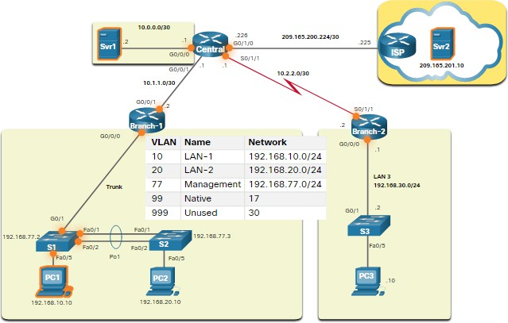
Network Documentation
Step 2 - Identify Devices and Ports of Interest
A logical network topology can be useful in identifying key devices and ports to monitor.
As shown in the sample topology, the devices and ports of interest include:
PC1 (the Admin terminal)
Two servers (i.e., Srv1 and Svr2)
Router interfaces
Key ports on switches

Slide 10
Step 3 - Determine the Baseline Duration
Network Documentation
When capturing data for analysis, the period specified should be:
At a minimum, seven days long.
Last no more than six weeks, unless specific long-term trends need to be measured.
Generally, a two-to-four-week baseline is adequate.
Conduct an annual analysis of the entire network, or baseline different sections of the network on a rotating basis.
Analysis must be conducted regularly to understand how the network is affected by
growth and other changes.

Slide 11
Network Documentation
Data Measurement
The table lists some of the most common Cisco IOS commands used for data collection.
Command | Description
show version | Displays uptime, version information for device software and hardware
show ip interface [brief] show ipv6 interface [brief] | Displays all the configuration options that are set on an interface.
show interfaces | Displays detailed output for each interface.
show ip route [static | eigrp | ospf | bgp] show ipv6 route [static | eigrp | ospf | bgp] | Displays the routing table content listing directly connected networks and learned remote networks.
show cdp neighbors detail | Displays detailed information about directly connected Cisco devices.
show arp show ipv6 neighbors | Displays the contents of the ARP table (IPv4) and the neighbor table (IPv6).
show running-config | Displays current configuration.
show vlan | Displays the status of VLANs on a switch.
show port | Displays the status of ports on a switch.
show tech-support | Used to collect a large amount of information using multiple show commands for technical support reporting purposes.

Slide 12
12.2 Troubleshooting Process

Slide 13
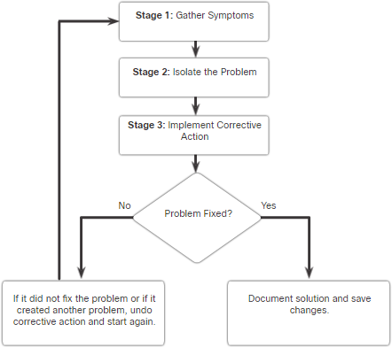
General Troubleshooting Procedures
Troubleshooting Process
Troubleshooting can be time consuming because networks differ, problems differ, and troubleshooting experience varies.
Using a structured troubleshooting method will shorten overall troubleshooting time.
There are several troubleshooting processes that can be used to solve a problem.
The figure displays the logic flowchart of a simplified three-stage troubleshooting process.

Slide 14
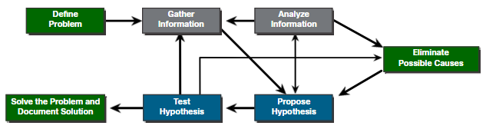
Troubleshooting Process
Seven-Step Troubleshooting Process
The figure displays a more detailed seven- step troubleshooting process.
Steps | Description
Define the Problem | Verify that there is a problem and then properly define what the problem is.
Gather Information | Targets (i.e., hosts, devices) are identified, accessed, and information gathered.
Analyze Information | Identify possible causes using network documentation, network baselines, knowledge bases, and peers.
Eliminate Possible Causes | Progressively eliminate possible causes to eventually identify the most probable cause.
Propose Hypothesis | When the most probable cause has been identified, a solution must be formulated.
Test Hypothesis | Assess the urgency of the problem, create a rollback plan, implement the solution, and verify outcome.
Solve the Problem | When solved, inform all involved and document the cause and solution to help solve future problems.

Slide 15
Troubleshooting Process
Question End Users
The table provides questioning guidelines and sample open ended end-user questions.
Guidelines | Example Open Ended End-User Questions
Ask pertinent questions. | What does not work? What exactly is the problem? What are you trying to accomplish?
Determine the scope of the problem. | Who does this issue affect? Is it just you or others? What device is this happening on?
Determine when the problem occurred / occurs. | When exactly does the problem occur? When was the problem first noticed? Were there any error message(s) displayed?
Determine if the problem is constant or intermittent. | Can you reproduce the problem? Can you send me a screenshot or video of the problem?
Determine if anything has changed. | What has changed since the last time it did work?
Use questions to eliminate or discover possible problems. | What works? What does not work?

Slide 16
Troubleshooting Process
Gather Information
Common Cisco IOS commands used to gather network problem symptoms.
Command | Description
ping {host |ip-address} | Sends an echo request packet to an address, then waits for a reply.
traceroute destination | Identifies the path a packet takes through the networks.
telnet {host | ip-address} | Connects to an IP address using the Telnet application (Note: Use SSH whenever possible).
ssh -l user-id ip-address | Connects to an IP address using SSH.
show ip interface brief show ipv6 interface brief | Displays a summary status of all interfaces on a device.
show ip route show ipv6 route | Displays the current IPv4 and IPv6 routing tables.
show protocols | Displays the global and interface-specific status of any configured Layer 3 protocol.
debug | Displays a list of options for enabling or disabling debugging events.

Slide 17
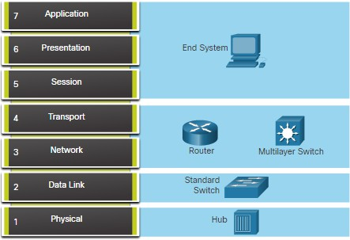
Troubleshooting Process
Troubleshooting with Layered Models
The OSI and TCP/IP models can be applied to isolate network problems when troubleshooting.
The figure shows some common devices and the OSI layers that must be examined during the troubleshooting process for that device.

Slide 18
Troubleshooting Process
Structured Troubleshooting Methods
Different troubleshooting approaches that can be used include the following.
Troubleshooting Approach | Description
Bottom-Up | Good approach to use when the problem is suspected to be a physical one.
Top-Down | Use this approach for simpler problems, or when you think the problem is with a piece of software.
Divide-and-Conquer | Start at a middle layer (i.e, Layer 3) and tests in both directions from that layer.
Follow-the-Path | Used to discover the actual traffic path from source to destination to reduce the scope of troubleshooting.
Substitution | You physically swap a suspected problematic device with a known, working one.
Comparison | Attempts to resolve the problem by comparing a nonoperational element with the working one.
Educated guess | Success of this method varies based on your troubleshooting experience and ability.

Slide 19
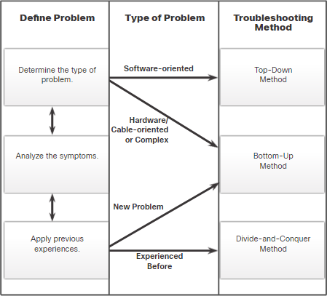
Guidelines for Selecting a Troubleshooting Method
Troubleshooting Process
To quickly resolve network problems, take the time to select the most effective network troubleshooting method.
The figure illustrates which method could be used when a certain type of problem is discovered.
Troubleshooting is a skill that is developed by doing it.
Every network problem you identify and solve
gets added to your skill set.

Slide 20
12.3 Troubleshooting Process

Slide 21
Troubleshooting Tools
Software Troubleshooting Tools
Common software troubleshooting tools include the following:
Software Tool | Description
Network Management System Tools | Network software include device-level monitoring, configuration, and fault-management tools. Tools can be used to investigate and correct network problems.
Knowledge Bases | Online network device vendor knowledge bases have become indispensable sources of information. When vendor-based knowledge bases are combined with internet search engines, a network administrator has access to a vast pool of experience-based information.
Baselining Tools | Many tools for automating the network documentation and baselining process are available. Baselining tools help with common documentation tasks such as network diagrams, update network software and hardware documentation, and cost-effectively measure baseline network bandwidth use.

Slide 22
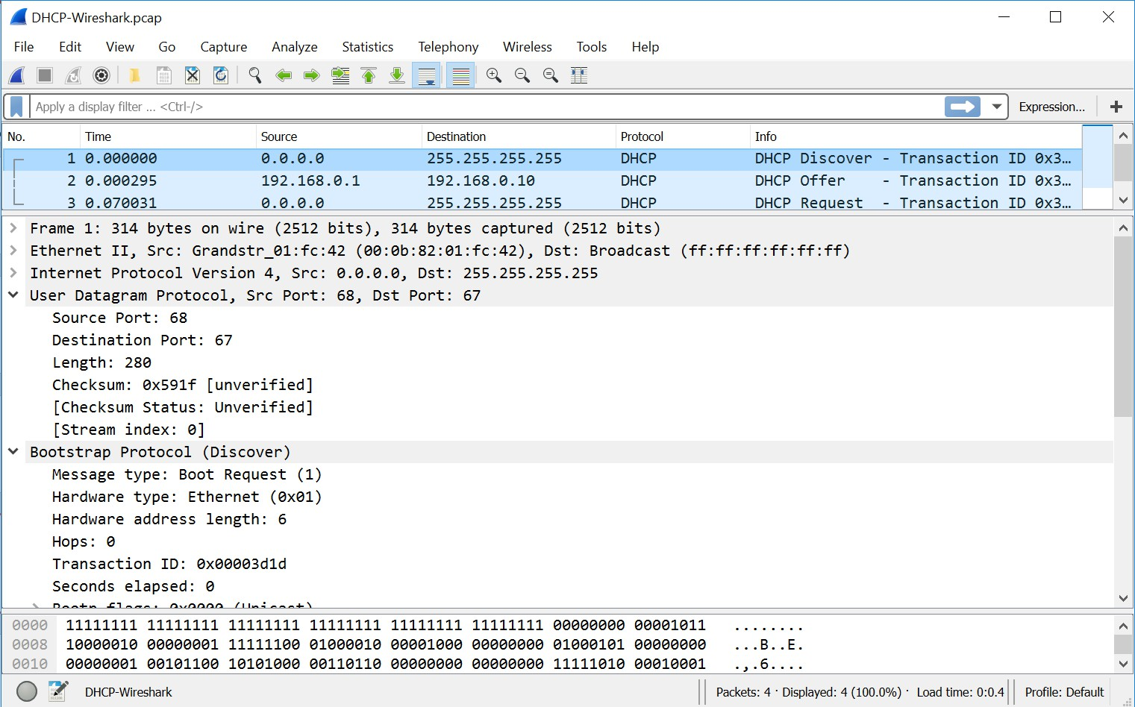
Protocol Analyzers
Troubleshooting Tools
A protocol analyzer can capture and display the physical layer to the application layer information contained in a packet.
Protocol analyzers, such as Wireshark, can help troubleshoot network performance problems.

Slide 23
Troubleshooting Tools
Hardware Troubleshooting Tools
There are multiple types of hardware troubleshooting tools.
Hardware Tools | Description
Digital Multimeters | Devices measure electrical values of voltage, current, and resistance.
Cable Testers | Handheld devices are designed for testing the various types of data communication cabling.
Cable Analyzers | Multifunctional handheld devices used to test and certify copper and fiber cables.
Portable Network Analyzers | Specialized device used for troubleshooting switched networks and VLANs.
Cisco Prime NAM | Browser-based interface that displays device performance analysis in a switched and routed environment.

Slide 24

Troubleshooting Tools
Syslog Server as a Troubleshooting Tool
Syslog is used by syslog clients to send text-based log messages to a syslog server.
Log messages can be sent to the console, VTY lines, memory buffer, or syslog server.
Cisco IOS log messages fall into one of eight levels.
The lower the level number, the higher the severity level.
By default, the console displays level 6 (debugging) messages.
In the command output, level 0 (emergencies) to 5 (notifications) are sent to the syslog server at 209.165.200.225.
Level | Keyword
0 | Emergencies
1 | Alerts
2 | Critical
3 | Errors
4 | Warnings
5 | Notifications
6 | Informational
7 | Debugging

Slide 25
12.4 Symptoms and Causes of Network Problems

Slide 26
Symptoms and Causes of Network Problems
Physical Layer Troubleshooting
The table lists common symptoms of physical layer network problems.
Symptom | Description
Performance lower than baseline | Requires previous baselines for comparison. The most common reasons include overloaded or underpowered servers, unsuitable switch or router configurations, traffic congestion on a low-capacity link, and chronic frame loss.
Loss of connectivity | Loss of connectivity could be due to a failed or disconnected cable. Can be verified using a simple ping test. Intermittent connectivity loss can indicate a loose or oxidized connection.
Network bottlenecks or congestion | If a route fails, routing protocols could redirect traffic to sub-optimal routes. This can result in congestion or bottlenecks in parts of the network.
High CPU utilization rates | High CPU utilization rates indicates that a device is operating at or exceeding its design limits. If not addressed quickly, CPU overloading can cause a device to shut down or fail.
Console error messages | Error messages reported on the device console could indicate a physical layer problem. Console messages should be logged to a central syslog server.

Slide 27
Symptoms and Causes of Network Problems
Physical Layer Troubleshooting (Cont.)
The table lists issues that commonly cause network problems at the physical layer.
Problem Cause | Description
Power-related | Check the operation of the fans and ensure that the chassis intake and exhaust vents are clear.
Hardware faults | Faulty or corrupt NIC driver files, bad cabling, or grounding problems can cause network transmission errors such as late collisions, short frames, and jabber.
Cabling faults | Look for damaged cables, improper cable, and poorly crimped connectors. Suspect cables should be tested or exchanged with a known functioning cable.
Attenuation | Attenuation can be caused if a cable length exceeds the design limit for the media, or when there is a poor connection resulting from a loose cable, or dirty or oxidized contacts.
Noise | Local electromagnetic interference (EMI) can be generated by many sources, such as crosstalk, nearby electric cables, large electric motors, FM radio stations, police radio, and more.
Interface configuration errors | Causes can include incorrect clock rate, incorrect clock source, and interface not being turned on. This causes a loss of connectivity with attached network segments.
Exceeding design limits | A component could operate sub-optimally if it is being utilized beyond specifications.
CPU overload | Symptoms include processes with high CPU utilization percentages, input queue drops, slow performance, SNMP timeouts, no remote access, no DHCP services, Telnet, and pings are slow or fail to respond. © 2012 Cisco and/or its affiliates. All rights reserved. Cisco Confidential 27

Slide 28
Symptoms and Causes of Network Problems
Data Link Layer Troubleshooting
The table lists common symptoms of data link layer network problems.
Symptom | Description
No functionality or connectivity at the network layer or above | Some Layer 2 problems can stop the exchange of frames across a link, while others only cause network performance to degrade.
Network is operating below baseline performance levels | Frames can take a suboptimal path to their destination but still arrive causing the network to experience unexpected high-bandwidth usage on links. An extended or continuous ping can help reveal if frames are being dropped.
Excessive broadcasts | Operating systems use broadcasts and multicasts extensively. Generally, excessive broadcasts are the result of a poorly programmed or configured applications, a large Layer 2 broadcast domains, or an underlying network problems .
Console messages | Routers send messages when it detects a problem with interpreting incoming frames (encapsulation or framing problems) or when keepalives are expected but do not arrive. The most common console message that indicates a Layer 2 problem is a line protocol down message

Slide 29
Symptoms and Causes of Network Problems
Data Link Layer Troubleshooting
The table lists issues that commonly cause network problems at the data link layer.
Problem Cause | Description
Encapsulation errors | Occurs when bits placed in a field by the sender are not what the receiver expects to see.
Address mapping errors | Occurs when Layer 2 and Layer addressing is not available.
Framing errors | Framing errors can be caused by a noisy serial line, an improperly designed cable, faulty NIC, duplex mismatch, or an incorrectly configured channel service unit (CSU) line clock.
STP failures or loops | Most STP problems are related to forwarding loops that occur when no ports in a redundant topology are blocked and traffic is forwarded in circles indefinitely, excessive flooding because of a high rate of STP topology changes.

Slide 30
Symptoms and Causes of Network Problems
Network Layer Troubleshooting
The table lists common symptoms of network layer network problems.
Symptom | Description
Network failure | Occurs when the network is nearly or completely non-functional, affecting all users and applications on the network. These failures are usually noticed quickly by users and network administrators and are obviously critical to the productivity of a company.
Suboptimal performance | These involve a subset of users, applications, destinations, or a type of traffic. Optimization issues can be difficult to detect and even harder to isolate and diagnose. This is because they usually involve multiple layers, or even a single host computer. Determining that the problem is a network layer problem can take time.

Slide 31
Symptoms and Causes of Network Problems
Network Layer Troubleshooting (Cont.)
The table lists common symptoms of network layer network problems.
Problem Cause | Description
General network issues | Often a change in the topology may unknowingly have effects on other areas of the network. Determine whether anything in the network has recently changed, and if there is anyone currently working on the network infrastructure.
Connectivity issues | Check for any equipment and connectivity problems, including power problems, environmental problems, and Layer 1 problems, such as cabling problems, bad ports, and ISP problems.
Routing table | Check the routing table for anything unexpected, such as missing routes or unexpected routes.
Neighbor issues | Check to see if there are any problems with the routers forming neighbor adjacencies.
Topology database | Check the table for anything unexpected, such as missing entries or unexpected entries.
© 2012 Cisco and/or its affiliates. All rights reserved. Cisco Confidential 3
1

Slide 32
Symptoms and Causes of Network Problems
Transport Layer Troubleshooting - ACLs
The table lists areas where ACL misconfigurations commonly occur.
Misconfigurations | Description
Selection of traffic flow | An ACL must be applied to the correct interface in the correct traffic direction.
Order of access control entries | The entries in an ACL should be from specific to general.
Implicit deny any | The implicit ACE can be the cause of an ACL misconfiguration.
Addresses and IPv4 wildcard masks | Complex IPv4 wildcard masks are more efficient, but are more subject to configuration errors.
Selection of transport layer protocol | It is important that only the correct transport layer protocol be specified in an ACE.
Source and destination ports | Ensuring that the correct inbound and outbound ports are specified in an ACE
Use of the established keyword | The established keyword applied incorrectly, can provide unexpected results.
Uncommon protocols | Misconfigured ACLs often cause problems for protocols other than TCP and UDP.
© 2012 Cisco and/or its affiliates. All rights reserved. Cisco Confidential
32

Slide 33
Symptoms and Causes of Network Problems
Transport Layer Troubleshooting - NAT for IPv4
The table lists common interoperability areas with NAT.
Symptom | Description
BOOTP and DHCP | The DHCP-Request packet has a source IPv4 address of 0.0.0.0. However, NAT requires both a valid destination and source IPv4 address, therefore, BOOTP and DHCP can have difficulty operating over a router running either static or dynamic NAT. Configuring the IPv4 helper feature can help solve this problem.
DNS | A DNS server outside the NAT router does not have an accurate representation of the network inside the router. Configuring the IPv4 helper feature can help solve this problem.
SNMP | An SNMP management station on one side of a NAT router may not be able to contact SNMP agents on the other side of the NAT router. Configuring the IPv4 helper feature can help solve this problem.
Tunneling and encryption protocols | Encryption and tunneling protocols often require that traffic be sourced from a specific UDP or TCP port, or use a protocol at the transport layer that cannot be processed by NAT.
© 2012 Cisco and/or its affiliates. All rights reserved. Cisco Confidential 33

Slide 34
Symptoms and Causes of Network Problems
Application Layer Troubleshooting
The table provides a short description of these application layer protocols.
Applications | Description
SSH/Telnet | Enables users to establish terminal session connections with remote hosts.
HTTP | Supports the exchanging of text, graphic images, sound, video, and other multimedia files on the web.
FTP | Performs interactive file transfers between hosts.
TFTP | Performs basic interactive file transfers typically between hosts and networking devices.
SMTP | Supports basic message delivery services.
POP | Connects to mail servers and downloads email.
SNMP | Collects management information from network devices.
DNS | Maps IP addresses to the names assigned to network devices.
NFS | Network File System (NFS) enables computers to mount and use drives on remote hosts.

Slide 35
12.5 Troubleshooting IP Connectivity

Slide 36
Components of Troubleshooting End-to-End Connectivity
Troubleshooting IP Connectivity
Bottom-up approach steps when there is no end-to-end connectivity are as follows:
Check physical connectivity at the point where network communication stops.
Check for duplex mismatches.
Check data link and network layer addressing on the local network.
Verify that the default gateway is correct.
Ensure that devices are determining the correct path from the source to the destination.
Verify the transport layer is functioning properly.
Verify that there are no ACLs blocking traffic.
Ensure that DNS settings are correct.

Slide 37
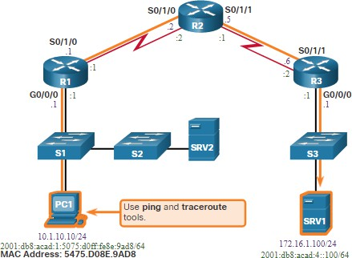
Troubleshooting IP Connectivity
End-to-End Connectivity Problem Initiates Troubleshooting
Usually what initiates a troubleshooting effort is the discovery that there is a problem with end-to-end connectivity.
Two of the most common utilities used to verify a problem with end-to-end connectivity are ping and traceroute.

Slide 38
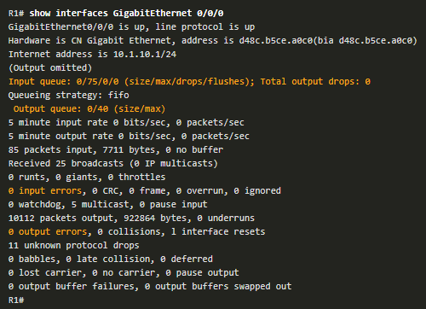
Step 1 - Verify the Physical Layer
Troubleshooting IP Connectivity
The show interfaces command is useful when troubleshooting performance- related issues and hardware is suspected to be at fault.
Of interest in the output are the:
Interface status
Input queue drops
Output queue drops
Input errors
Output errors

Slide 39
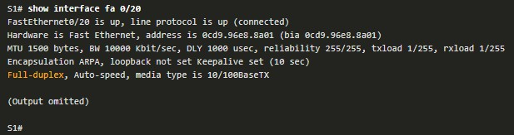
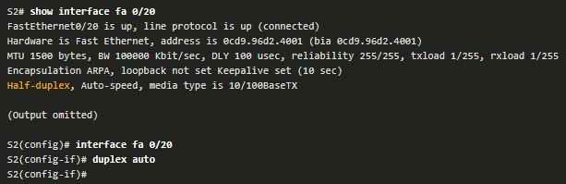
Troubleshooting IP Connectivity
Step 2 - Check for Duplex Mismatches
The IEEE 802.3ab Gigabit Ethernet standard mandates the use of autonegotiation for speed and duplex and practically all Fast Ethernet NICs also use autonegotiation by default.
Problems can occur when there is a duplex mismatch.

Slide 40
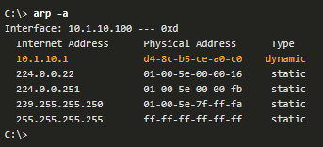
Troubleshooting IP Connectivity
Step 3 - Verify Addressing on the Local Network
The arp Windows command displays and modifies entries in the ARP cache that are used to store IPv4 addresses and their resolved Ethernet physical (MAC) addresses.

Slide 41


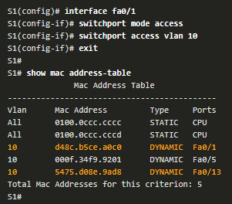
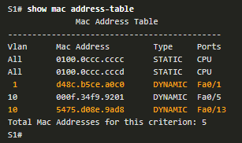
Troubleshooting IP Connectivity
Troubleshoot VLAN Assignment Example
Another issue to consider when troubleshooting end-to-end connectivity is VLAN assignment.
For example, the MAC address on Fa0/1 should
be in VLAN 10 instead of VLAN 1.
The following configuration changes Fa0/1 to
VLAN 10 and verifies the change.

Slide 42
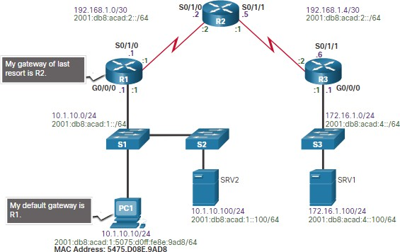
Step 4 - Verify Default Gateway
Troubleshooting IP Connectivity
Misconfigured or missing default gateways can cause connectivity problems.
In the figure for example, the default gateways for:
R1 is 192.168.1.2 (R2)
PC1 is 10.1.10.1 (R1 G0/0/0)
Useful commands to verify the default gateway on:
R1: show ip route
PC1: route print (or netstat –r)

Slide 43

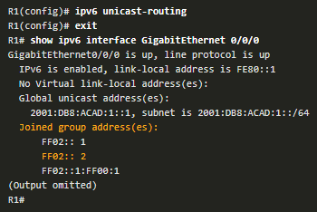
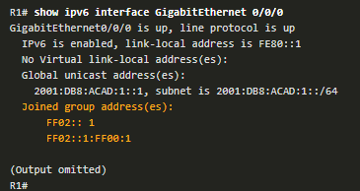
Troubleshooting IP Connectivity
Troubleshoot IPv6 Default Gateway Example
An IPv6default gateway can be configured manually, using SLAAC, or by using DHCPv6.
For example, a PC is unable to acquire its IPv6 configuration using SLAAC. The command output is missing the all IPv6-router multicast group (FF02::2).
R1 is enabled as an IPv6 router and now the output verifies that R1 is a member of ff02::2, the All-IPv6-Routers multicast group.

Slide 44
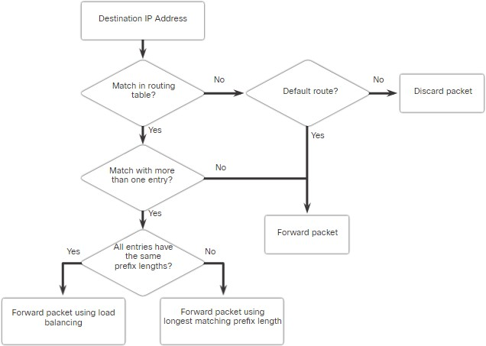
Step 5 - Verify Correct Path
Troubleshooting IP Connectivity
When troubleshooting, it is often necessary to verify the path to the destination network.
The figure describes the process for both the IPv4 and IPv6 routing tables.
The process of forwarding IPv4 and IPv6 packets is based on the longest bit match or longest prefix match.
The routing table process will attempt to forward the packet using an entry in the routing table with the greatest number of leftmost matching bits.
The number of matching bits is indicated by the prefix length of the route.

Slide 45
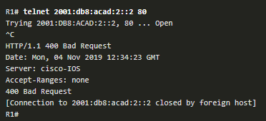
Troubleshooting IP Connectivity
Step 6 - Verify the Transport Layer
Two of the most common issues that affect transport layer connectivity include ACL configurations and NAT configurations.
A common tool for testing transport layer functionality is the Telnet utility.
For example, the administrator attempts to Telnet to R2 using port 80.

Slide 46
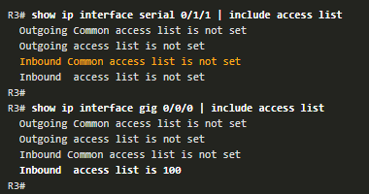
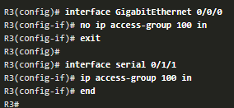
Troubleshooting IP Connectivity
Step 7 - Verify ACLs
On routers, there may be ACLs that prohibit protocols from passing through the interface in the inbound or outbound direction.
In this example, ACL 100 has been incorrectly configured inbound on the G0/0/0 instead of inbound on S0/1/1.
The ACL is removed from G0/0/0 and
configured inbound on S0/1/1.

Slide 47

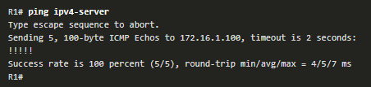
Step 8 - Verify DNS
Troubleshooting IP Connectivity
The DNS protocol controls the DNS, a distributed database with which you can map hostnames to IP addresses.
When you configure DNS on the device, you can substitute the hostname for the IP address with all IP commands, such as ping or telnet. command output.
Use the ip host global configuration command to enter a name to be used instead of the IPv4 address of the switch or router, as shown in the command output.
Use the nslookup Windows command to display the name-to-IP-address mapping information.

Slide 48
Troubleshooting IP Connectivity
Packet Tracer - Troubleshoot Enterprise Networks
In this Packet Tracer activity, you complete the following objectives:
Part 1: Verify Switching Technologies
Part 2: Verify DHCP
Part 3: Verify Routing
Part 4: Verify WAN Technologies
Part 5: Verify Connectivity

Slide 49
12.6 Module Practice and Quiz

Slide 50
Structured Design
Packet Tracer – Network Troubleshooting
In this Packet Tracer activity, you complete the following objectives:
Test network connectivity.
Compile host addressing information.
Remotely access default gateway devices.
Document default gateway device configurations.
Discover devices on the network.
Draw the network topology.

Slide 51
Structured Design
Packet Tracer – Troubleshoot Challenge – Use Documentation to Solve Issues
In this Packet Tracer activity, you complete the following objectives:
Use various techniques and tools to identify connectivity issues.
Use documentation to guide troubleshooting efforts.
Identify specific network problems.
Implement solutions to network communication problems.
Verify network operation.

Slide 52
What did I learn in this module?
Module Practice and Quiz
Common network documentation includes physical and logical network topologies, network device documentation, and network performance baseline documentation.
The troubleshooting process should be guided by structured methods such as the seven-step troubleshooting process: (i.e., 1. Define the problem, 2. Gather information, 3. Analyze information, 4. Eliminate possible causes, 5. Propose hypothesis, 6. Test hypothesis, and 7. Solve the problem).
Troubleshooting tools include NMS tools, knowledge bases, baselining tools, protocol analyzer, digital multimeters, cable testers, cable analyzers, portable network analyzers, Cisco Prime NAM, and syslog servers.
Physical layer problems cause failures and suboptimal conditions. Data link layer problems are typically caused by encapsulation errors, address mapping errors, framing errors, and STP failures or loops. Network layer problems include IPv4, IPv6, routing protocols (such as EIGRP, OSPF, etc.). Transport layer problems can be misconfigured NAT or ACLs. Application layer problems can result in unreachable or unusable resources.

Slide 53
What did I learn in this module? (Cont.)
Module Practice and Quiz
A bottom-up troubleshooting method can be used to solve connectivity problems. Start verifying the physical layer, check for duplex mismatches, verify addressing and default gateway, verify that the correct path is taken, and verify the transport layer.

Slide 54


